Slide 1
MODELING AND VERIFYING WEB-BASED TICKET VENDING MACHINE
INSE 6250 - WINTER 2020
SUBMITTED BY –
ADARSH ARAVIND (40082585)
SUBMITTED TO –
Dr. JAMAL BENTAHAR
Notes:
Hi, I’m Adarsh Aravind. Welcome to the presentation.
In this video I’ll explain the modelling and verification of web-based ticket vending machine.

Slide 2
AGENDA
INTRODUCTION
TOOL
APPLICATION
SYSTEM DESIGN
REQUIREMENTS
DEMO
Notes:
I’ll briefly explain what my system is... Design of the model…, Tool used for verifying the correctness of the model…, Requirements of the model…, and we will see the demo at the end of this presentation..

Slide 3

INTRODUCTION
SYSTEM MODELLING
SYSTEM VERIFICATION
MODEL CHECKING
Notes:
System modelling.., System verification.., model checking…! What are they?
System modelling is the process of developing abstract models of a system, with each model presenting a different view or perspective of that system.
System Verification is a set of actions used to check the correctness of any element.
Model checking which is also known as correctness… is a method for checking whether a finite-state model of a system meets a given specification.

Slide 4
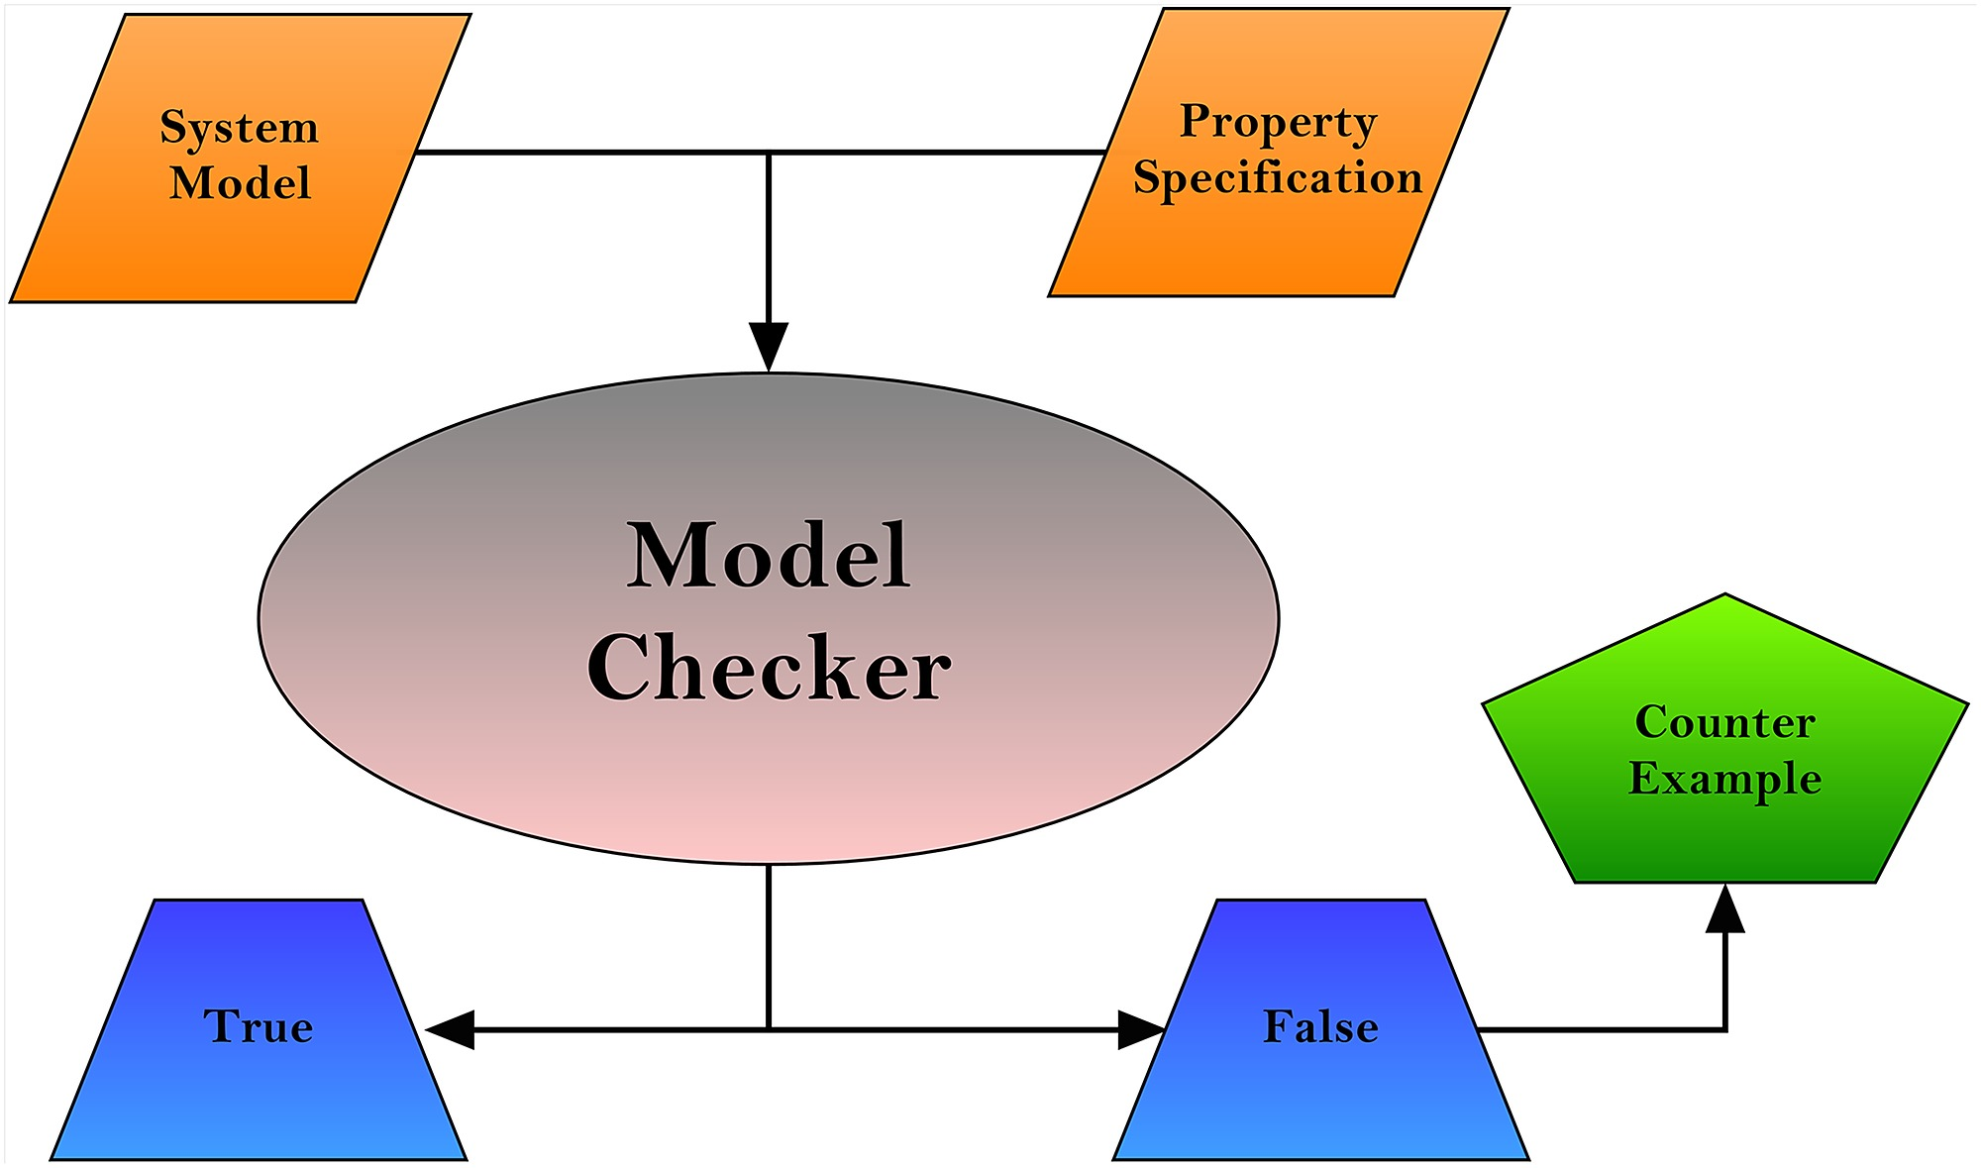
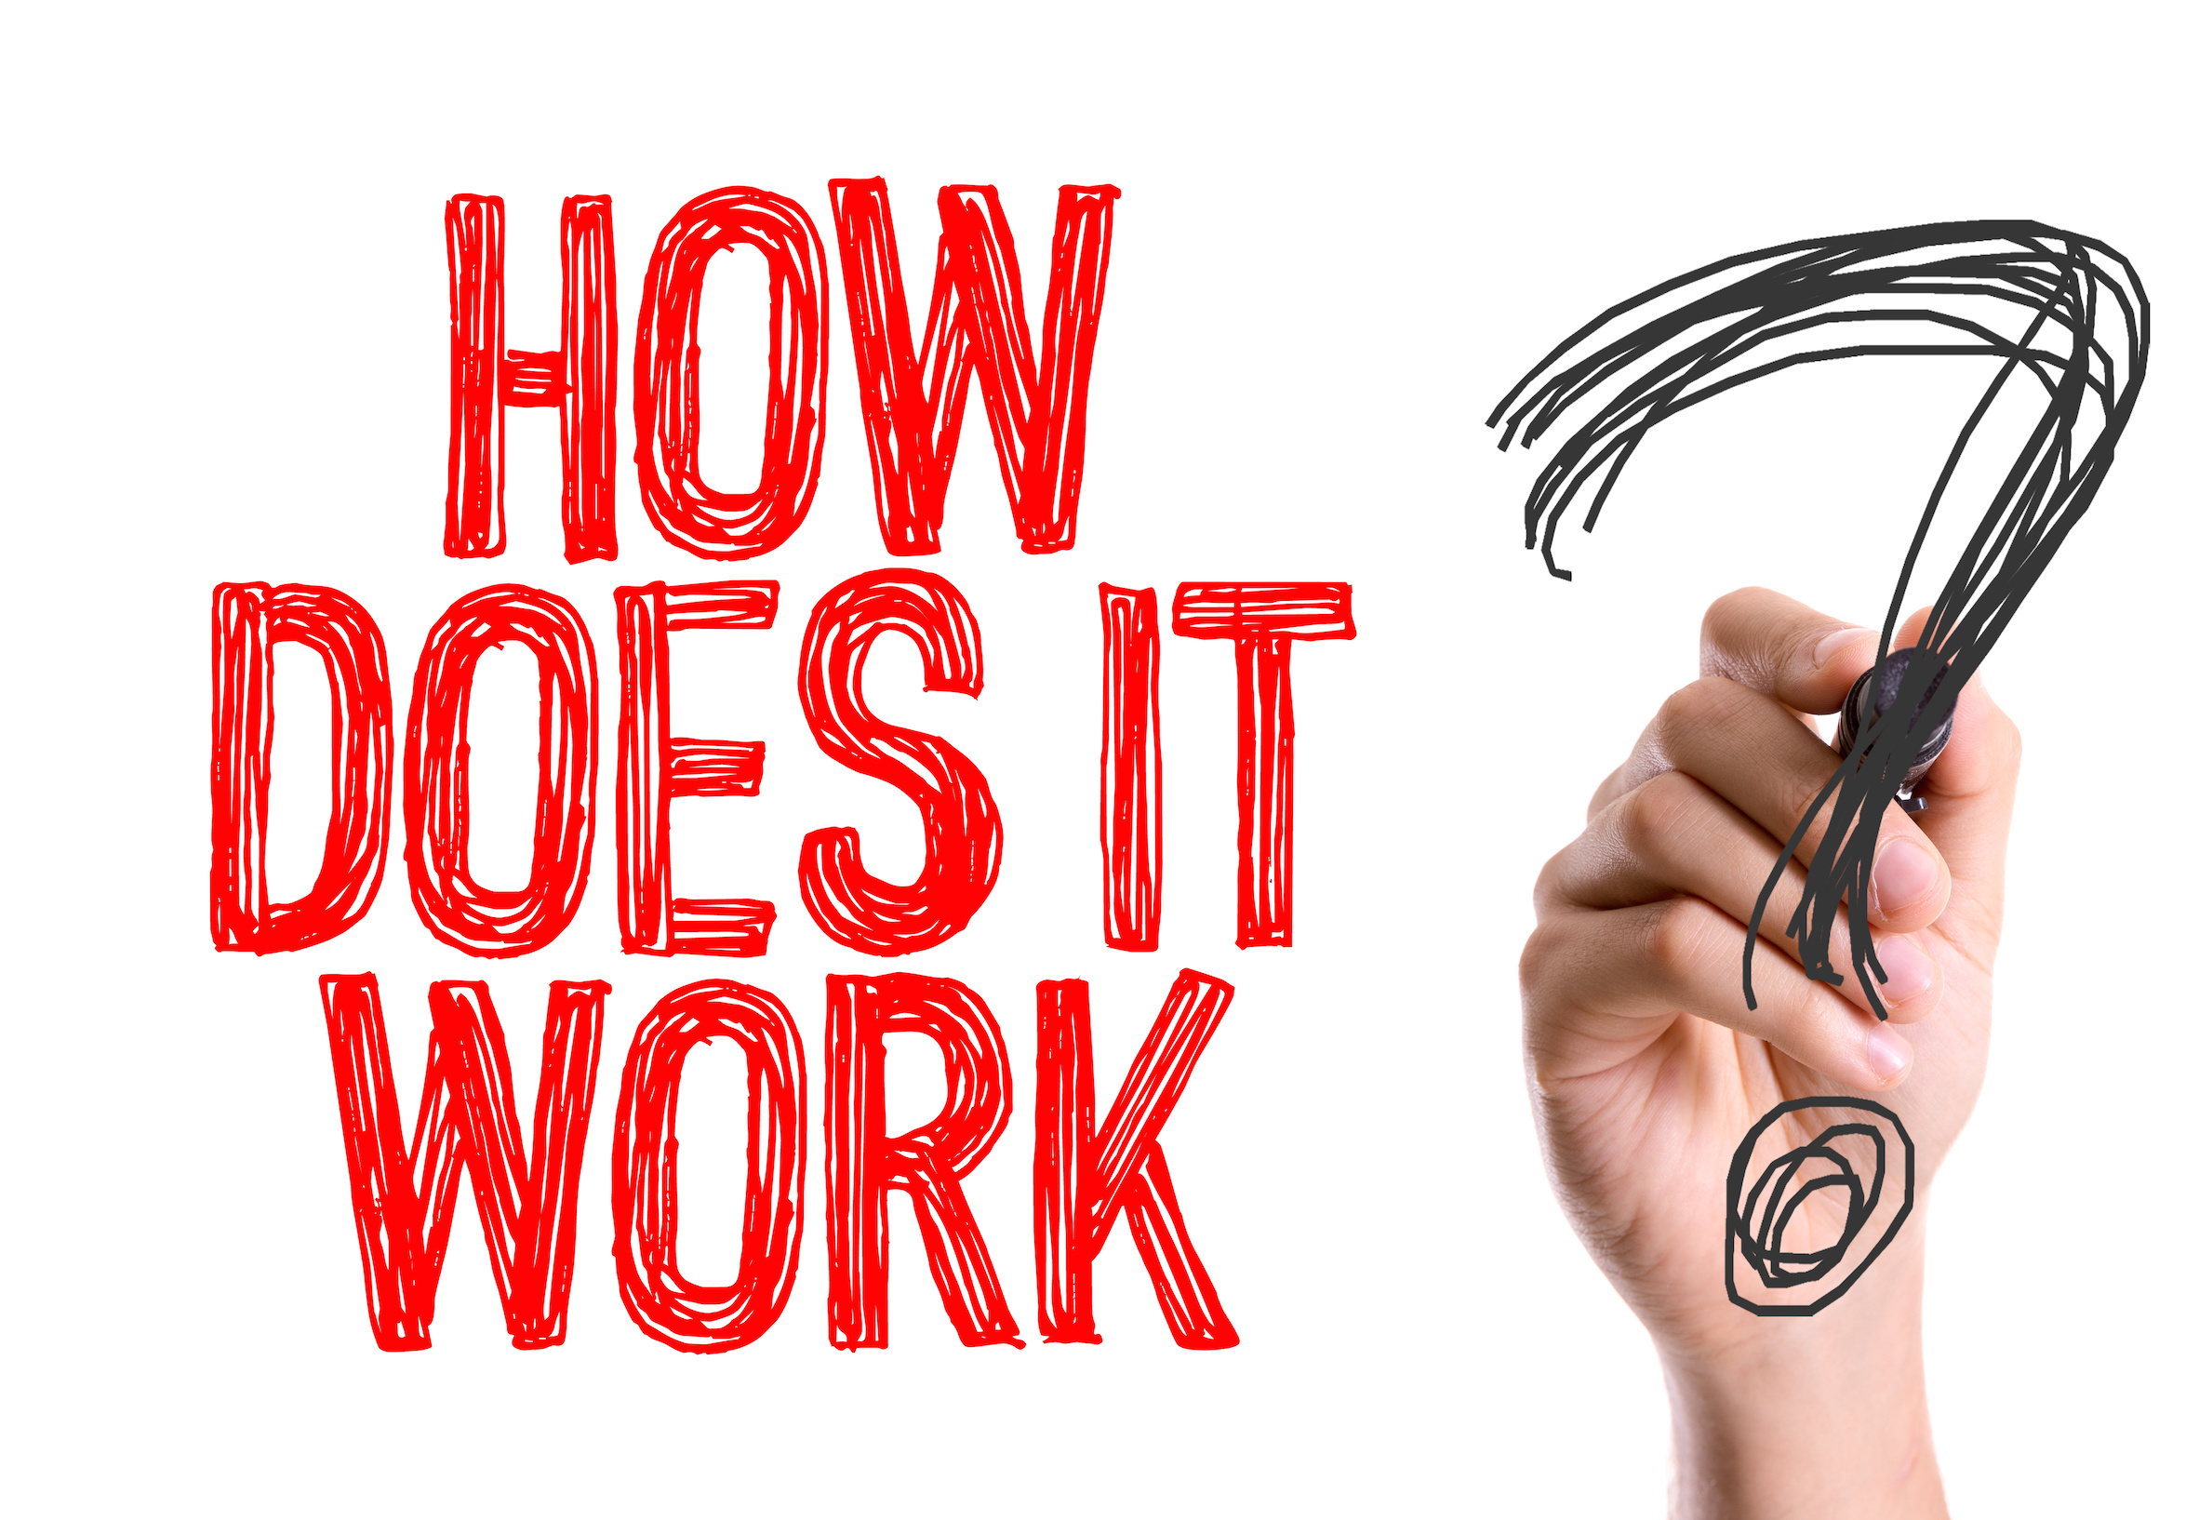
INTRODUCTION (CONT…)
EMC
SMV
NuSMV
Spin
UPPAAL
BLAST
Notes:
This slide shows a few model checker tools… and there are a lot more outside. What is a model checker? And how does it all work??
An application or a tool that is used to check the correctness of a model is known as model checker.
System model and system requirements are given as an input to the tool and the application will say if the system satisfies the requirements or not. If a requirement fails, the tool gives you a counter example. This is how a model checker works, but not all the tools will give you counter examples.

Slide 5
UPPAAL
UPPAAL is an integrated tool environment for modelling, validation and verification of real-time systems modelled as networks of timed automata, extended with data types
Goal:
Modelling and analysis of real-time systems, including concurrent programs.
Notes:
UPPAAL is an integrated tool environment for modelling, validation and verification of real-time systems.
What can we do with UPPAAL?
Unlike many other tools, UPPAAL will provide counter examples when a property isn’t satisfied. This helps a developer to detect and rectify errors in the system,
Properties can be easily specified as CTL formulas, System can be modelled graphically as finite state automata,
Timed automata can be built. This is helpful for systems which has session timeout.

Slide 6
APPLICATION
WEB-BASED TICKET VENDING MACHINE FOR MONTREAL METRO
Avoids long queues!
Recharge OPUS or buy tickets remotely.
All you need is a device with internet connection.
Notes:
In Montreal, people must top up their OPUS card balance at the beginning of every month via physical Ticket Vending Machines.
In order to top up their OPUS card, people often wait in long queues in front of TVM machines.
The travelling process could be interrupted due to the fact that people usually forget to top up their OPUS card on time.
In order to avoid this, the web-based application plays as an online platform allowing travellers to top up their OPUS cards and manage transactions themselves.

Slide 7
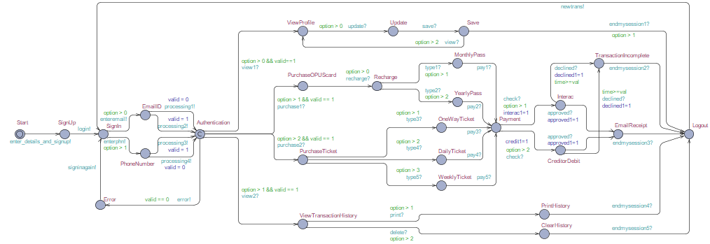
MODEL IN UPPAAL
Notes:
This is how my system looks like on UPPAAL. I have used 3 templates namely TVM_Server…, Bank…, and User.

Slide 8
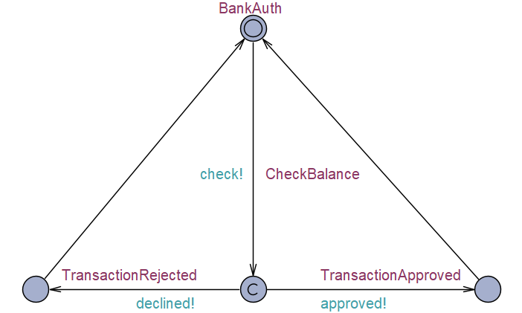
MODEL IN UPPAAL (CONT…)
Notes:
This is the template of Bank, where it authenticates if a user has sufficient balance to make the payment.

Slide 9
PROPERTIES
Every time, if a user wants to purchase a ticket or OPUS card, he/she should sign in to the system.
Users can either sign in to the system with their Phone number or Email ID.
For each sign in, the system will authenticate user details.
If the authentication fails, users will have to check their credentials and sign in again.
Users can choose any of the 4 options in the system (View Profile||Purchase OPUS Card||Purchase Ticket||View Transaction History).

Slide 10
PROPERTIES (CONT…)
Payment will be declined automatically by the system if the session expires.
If there is any purchase(s) made, the user should make the payment before they logout from the system.
Only when there is sufficient balance in the bank account, the transaction will be approved.
User can either print their transaction history or they can clear it, but can’t do both at a time.
Only when a user purchases OPUS card or ticket, a receipt will be emailed.

Slide 11
PROPERTIES (CONT…)
Users can always select between the 2 payment options. (Interac or CreditorDebit)
After every transaction, a user should logout from the system before making the next transaction.
Users can purchase only one type of ticket at a time.

Slide 12
DEMO
Drive link:
https://drive.google.com/open?id=1sRIcaRil5wyo8NcFYDJcyu6gWkjkEZwH
GitHub link:
https://github.com/AdarshArvind/Model-checking-with-UPPAAL
Notes:
Now I’ll simulate my model on UPPAAL…, and You can also download .xml file from these above mentioned links and run it on the latest version of UPPAAL tool.

Slide 13
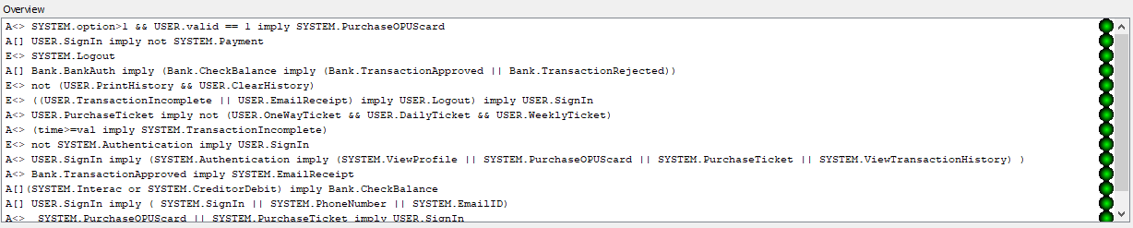
RESULTS
All the properties were converted to CTL formulas and verified on UPPAAL!
Notes:
Here is a screenshot of the verified properties which I already showed in the demo.

Slide 14
THANK YOU!
Notes:
Thank you… Have a great time.

